Slide 1

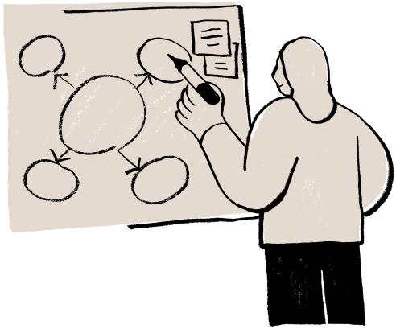
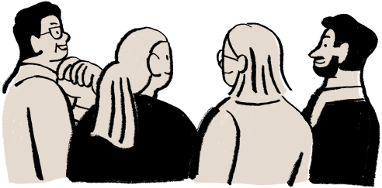
the COMP & CPEG mentor-mentee scheme for the 2025-2026
INTRO: THE 1ST STEP OF JOURNEY
Github Repository Page

Slide 2


What is the scheme about
What might be the scheme NOT about
1st Step to the Journey
Next Step ...
Menu

Slide 3
ABOUT
Chill, Refresh your minds
( by introducing Outside Major Stuff)
Sharing Thoughts/ Ideas /Experience
Reach out your peers
Other things your expected from the scheme (I’ll try)

Slide 4


Chill, Refresh your minds
In Our Major
Outside Our Major

Slide 5
Sharing Your experience
Or Expectation to the scheme
Even complains about some courses (such as hard courses)

Slide 6
(MIGHT NOT) ABOUT
Hardcore stuff about certain courses
(if you want, pls ask me in person, not in meeting, since it sometimes time-consuming)
High-end technical stuff
(I am not a pro in technology (for now) :( , so what we discuss would mainly be down-to-earth, basic things)

Slide 7
YOUR 1ST STEP
Github
Typst

Slide 8
Github
A safe place storing your codes
Record your learning path + contributions
“Evidence” of What You Learnt
Numbers of Fun Projects
Social Plateform (for computer engineers...)

Slide 9

if your code were accidently deleted, Github could keep your code of latest version.
“Pull Request” is a useful feature when working with team.
“Fork” allows you easily access others’ repository (for purpose of learning or just for fun)

Slide 10

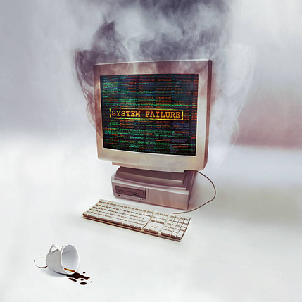
Less Risk of Losing Your Code
Showing your motivation to learn, also your acheivements

Slide 11

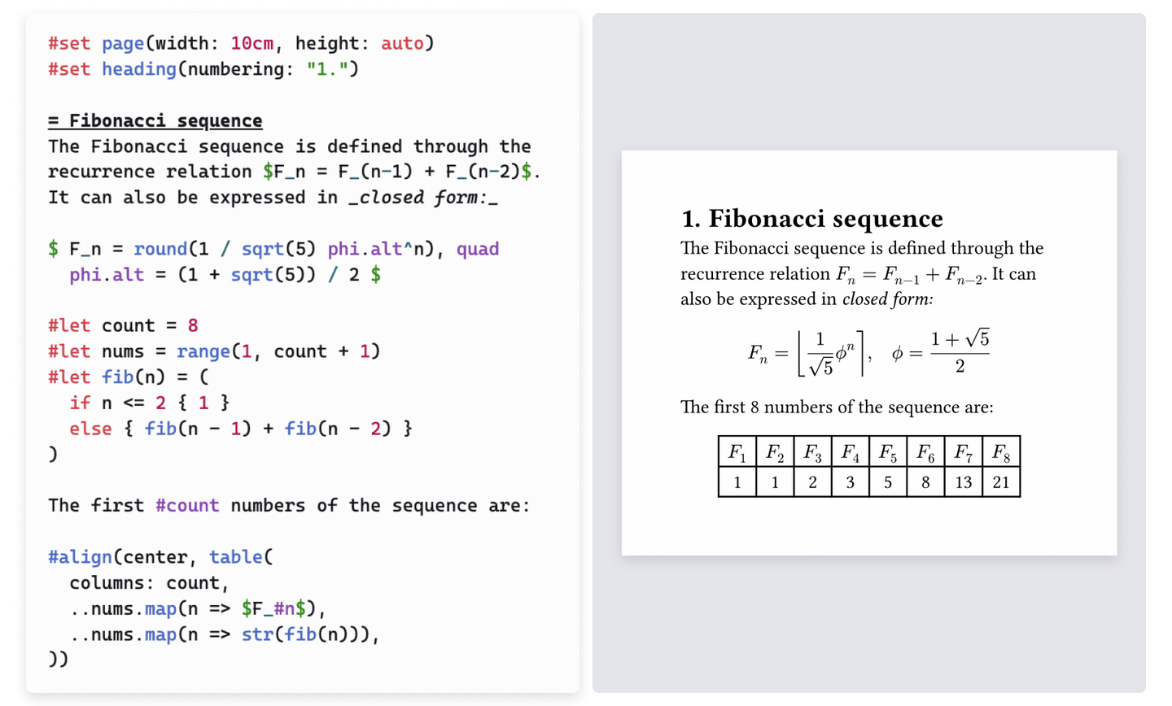
Typst
https://github.com/typst/typst
Code → Images
→ Easy to modify
→ looks more professional
(When building resume)
→ unlike Microsoft Word

Slide 12
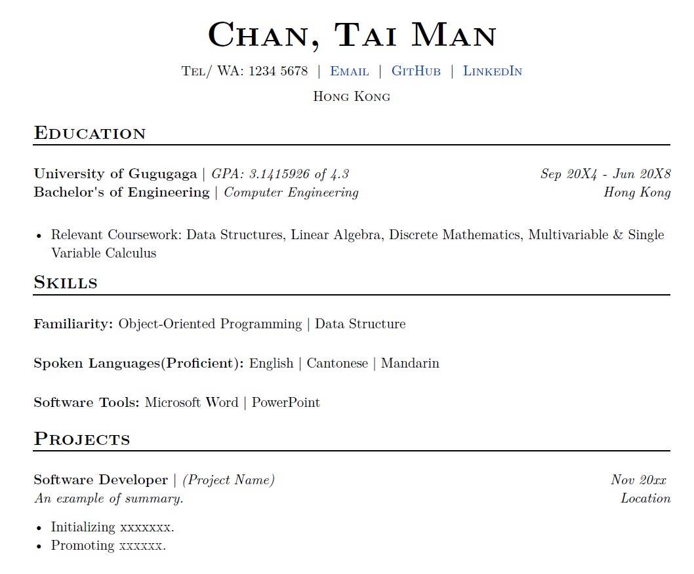
Example of Typst

Slide 13
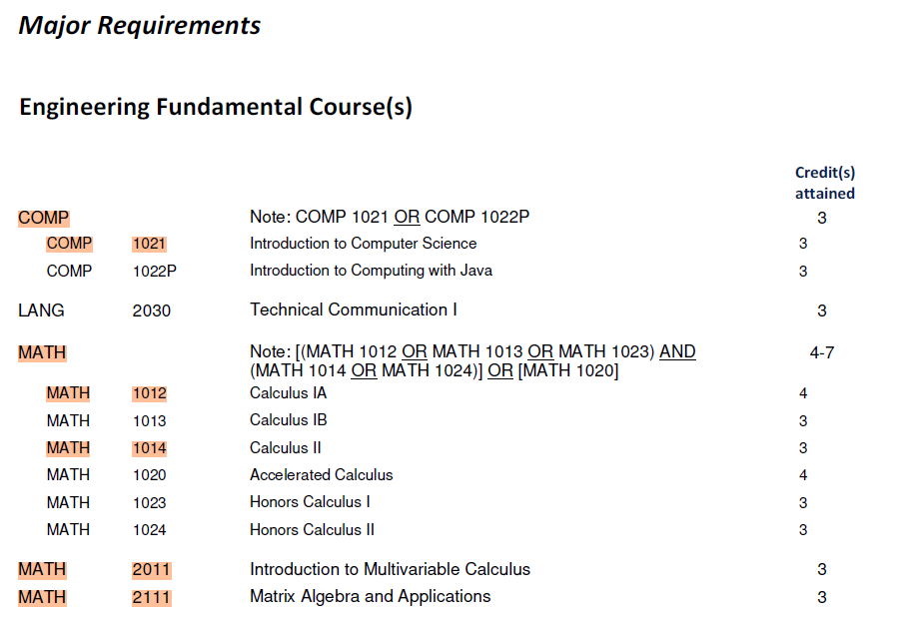
MY ENROLLED COURSES
Highlighted => My Taken Courses
Link of the document

Slide 14
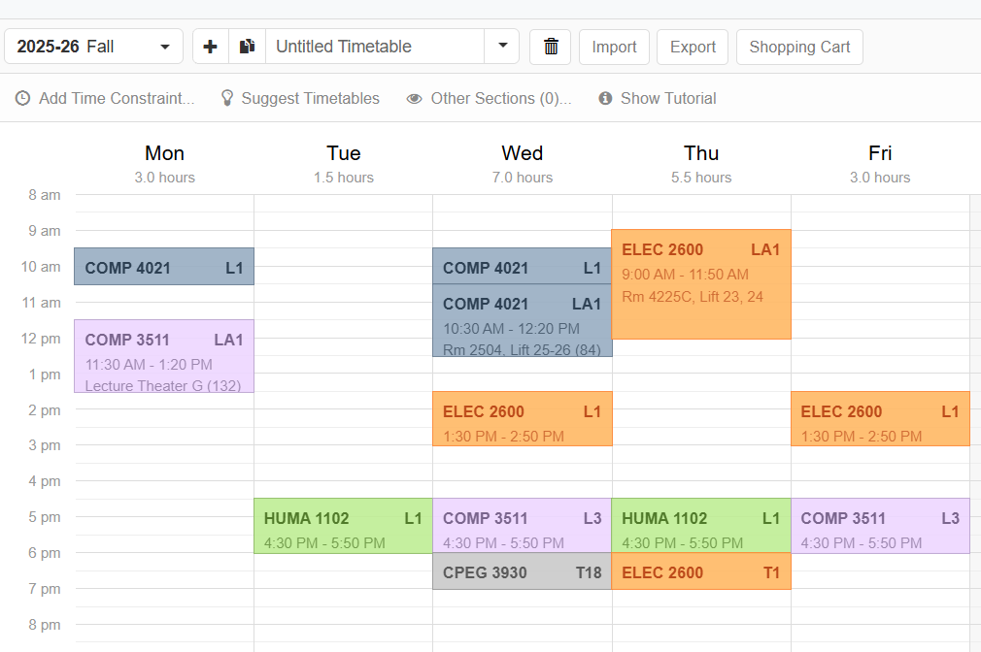
MY TIMETABLE

Slide 15
NEXT STEP
Meeting Dates For Fall / Spring
1. Before the end of add-drop period
2. After mid-term
Any feedbacks ?
You can also leave your comments in “issues” !

Slide 16
The reason why we focus on technology and resume stuff is, it is summer.
For fall and spring, our meeting would focus less on skill-building, but more on non-technical stuff, even it is not so related to our major
such as Art or Psychological topics
SInce the reason you come for the meeting, would be “refreshing your mind”, rather than repeating lecture notes on required courses, right 🙂 ?

Slide 17
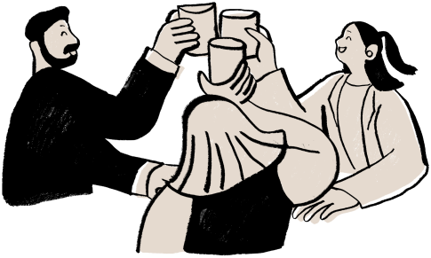
Fradel and Spies
THANK YOU
FOR YOUR ATTENTION!
Get in touch:
Tel/ Whatsapp/ WeCHat:
+852 6676 4689
Email: xhuangda@connect.ust.hk

